Slide 1

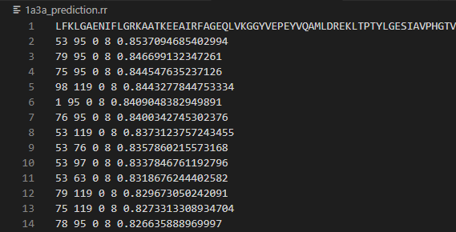
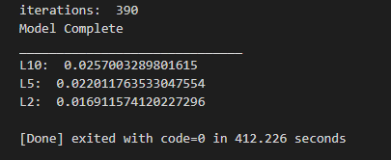
Sam Gass
Training:
Classification:
Training Process:
Clean data
Split data
Equal parts contact and noncontact
Gradient Ascent
Weights start at 0
Intermediate Stochastic and Batch
100 sample size
2000 iterations
Pickle weights
Test model
L/10, L/5, and L/2
Classification Process:
Open model
Convert .pssm to features
Use model to calculate probability of contact
Write to .rr file
From Command Line:
Example .rr file:
Model Accuracy:

